Slide 1
EpIG-DB 2.0: results and analyses
Revised structure for the database manuscript

Slide 2
Variables used in the revised analyses
Database identifiers and structure
PlotObservationID, PlotID, DATASET, Plot.Tree
Geographic coverage
Country, Longitude, Latitude, Altitude, ECO_NAME, BIOME
Sampling metadata
Taxonomic.scope, Life.Form.scope, Sampling.method, Sampling.unit.strategy, Abundance.method
Host-tree information
Host.tree.name, Host.tree.DBH, Host_height..m.
Completeness fields
Empty.trees..y.n., Naturalness, Vegetation.type, Location.uncertainty..m.
Environmental predictors
Current climate, LGM climate, cloud forest, aridity and evapotranspiration variables

Slide 3
Validation checklist before final rendering
Before final rendering:
Verify that the current header and species objects are final.
Review incomplete or invalid coordinates and report exclusions explicitly.
Derive biomes and ecoregions from the database rather than hard-coding values.
Validate extreme elevation, DBH and height values against the source datasets.
Verify taxon counts and sampling-code definitions against the data dictionary.
Correct period-separated sampling strategies before counting.
Confirm that host-tree DBH is expressed in centimetres.

Slide 4
Results structure implemented in the updated QMD
1 Database expansion
Overall growth and community-matrix coverage
2 Geographic coverage
Country expansion, sampling distribution and sampling intensity
3 Taxonomic and ecological coverage
Taxonomic scope, life forms and species representation
4 Sampling structure
Sampling units, abundance information, sampling methods and strategies
5 Data completeness
Metadata completeness, numeric ranges and empty sampling units

Slide 5
Figure decisions

Slide 6
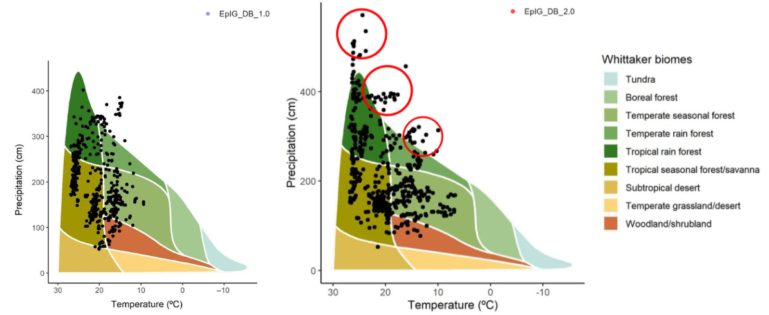
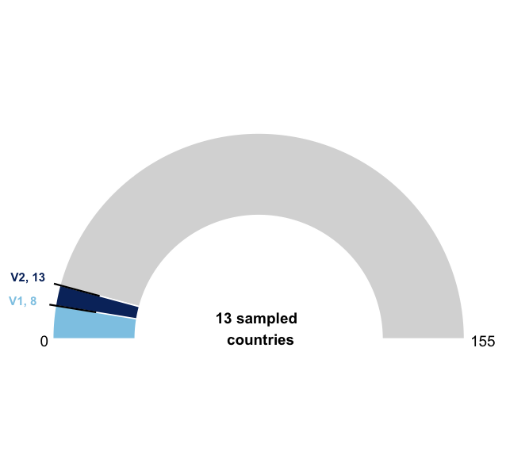
Species representation
Implemented as rank-frequency curves in the updated QMD. These can be replaced by individual-abundance Whittaker curves when a harmonized abundance field is available for both versions.

Slide 7
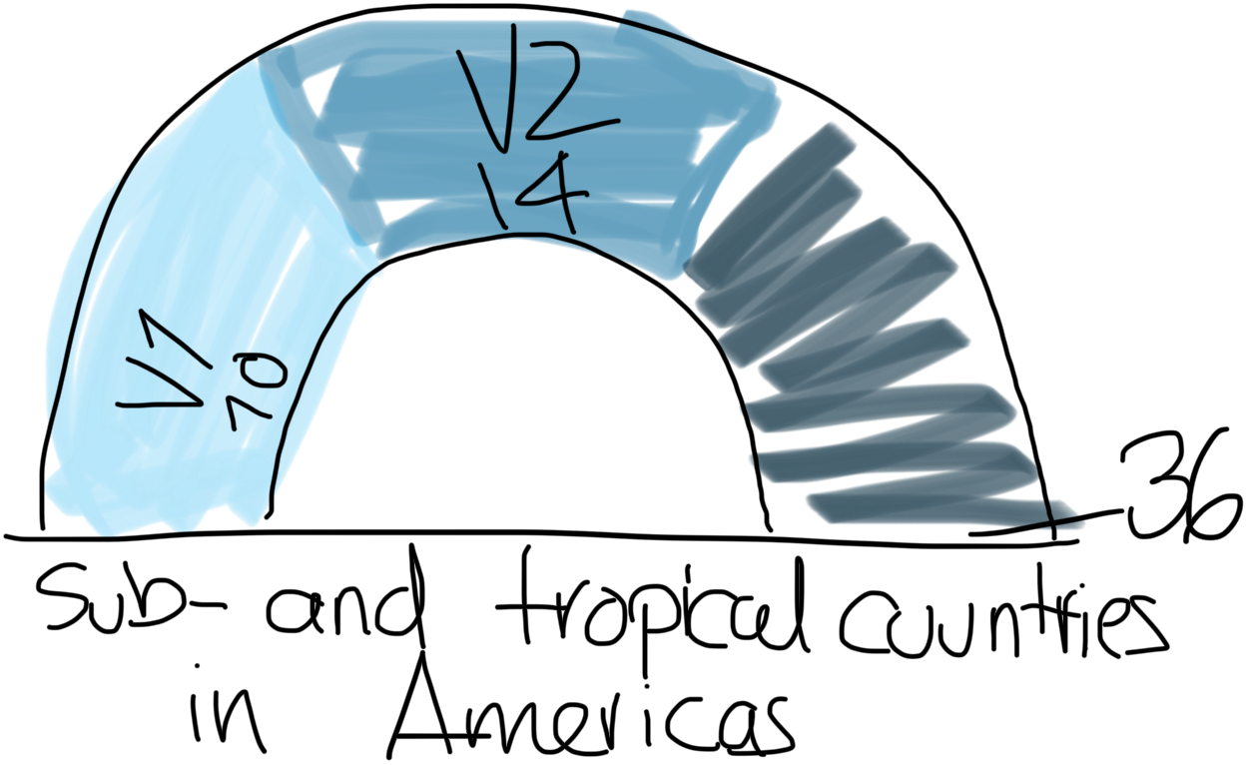
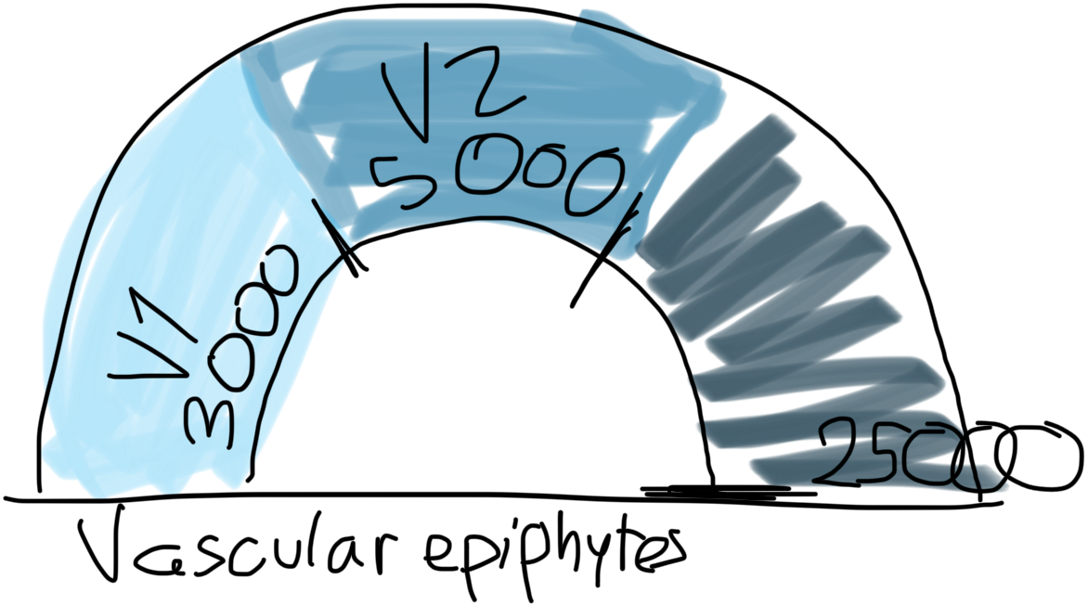
Gauge chart — removed from the final QMD
Decision: remove the gauge chart from the final QMD. Its denominator is not inherent to the database and a direct V1–V2 comparison communicates the result more clearly.
Status: superseded by the overall database-growth table and the geographic-expansion map.

Slide 8
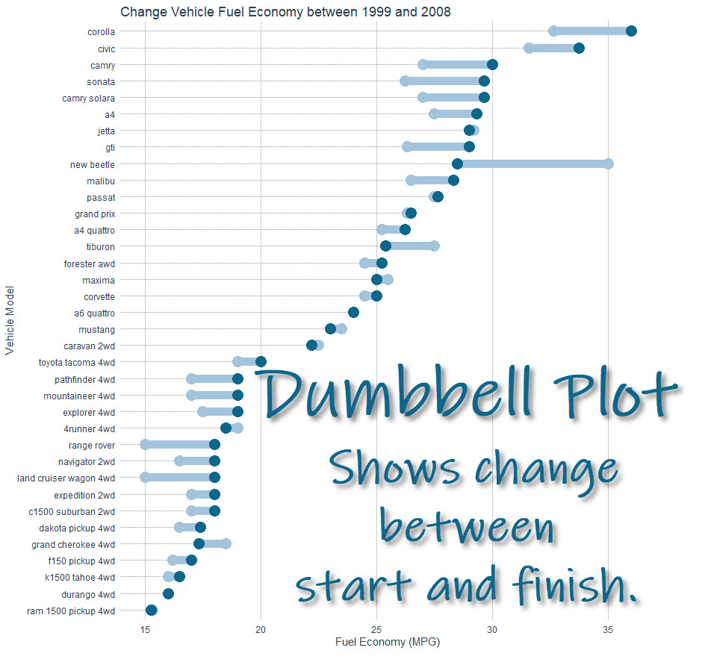
V1–V2 comparisons — dumbbell plots retained
Typical packages:
ggplot2
ggalt (classic dumbbell support)
or manual geom_point + geom_segment
Your use case:
species per country in V1 vs V2
Perfect fit.
Structure:
left point = V1
right point = V2
line connects them
Retained for categorical V1–V2 comparisons because it shows exact direction and magnitude without the scale distortion of radar plots.

Slide 9
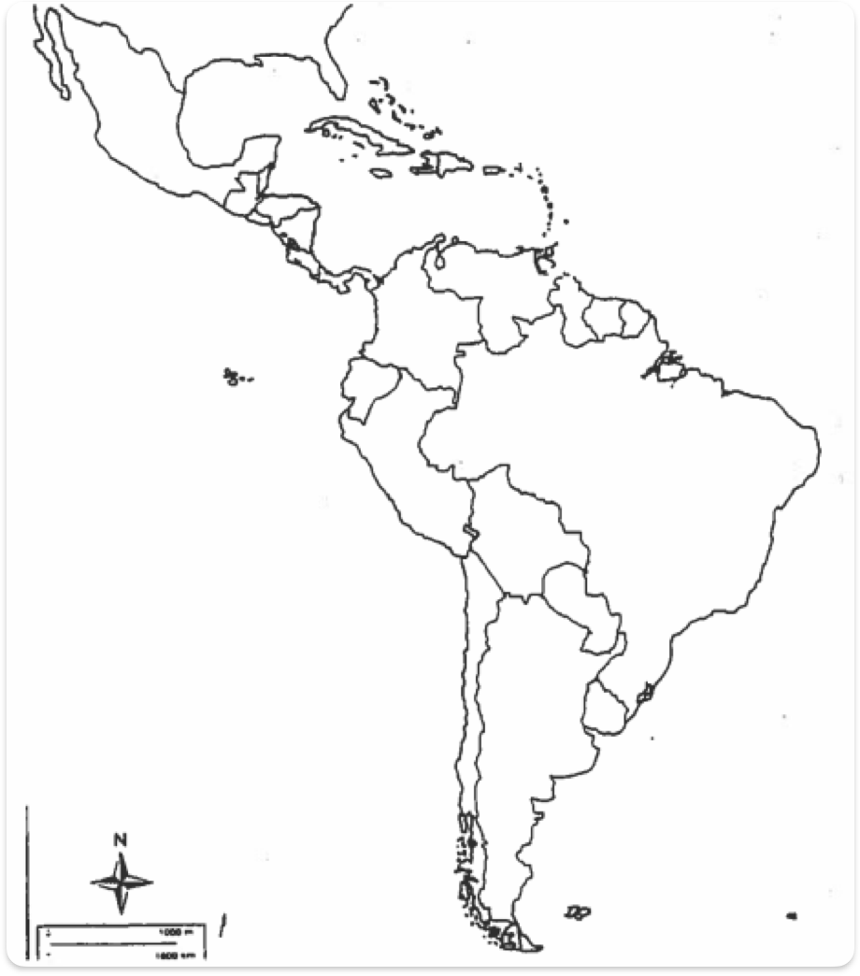
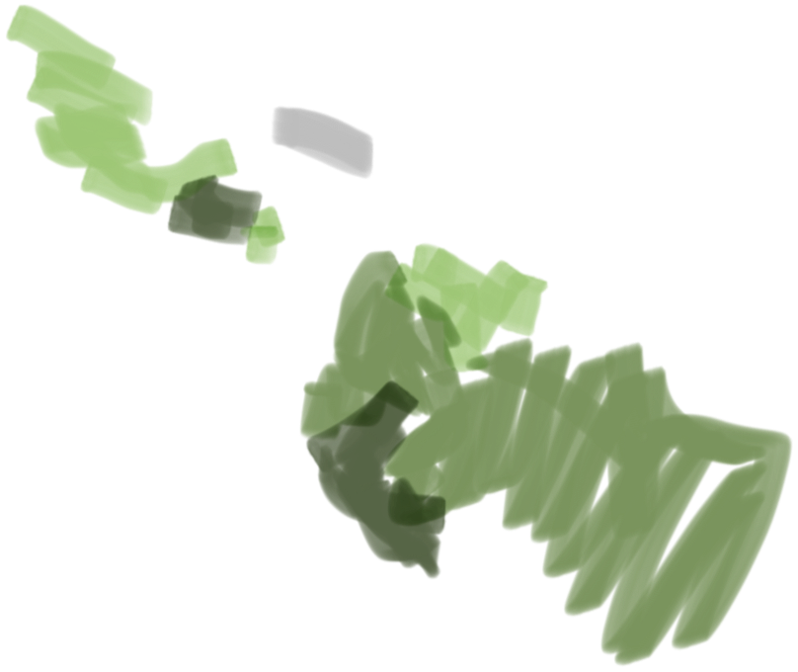
Geographic expansion
“layered spatial weighting visualization”
You can encode:
V1 = grey base layer
V2 = green gradient intensity
additional variable = color saturation or alpha
R tools:
ggplot2
sf (for spatial data)
viridis or custom gradients
Implemented as two complementary results: geographic expansion identifies newly represented countries, and sampling intensity shows the number of sampling units per country.

Slide 10
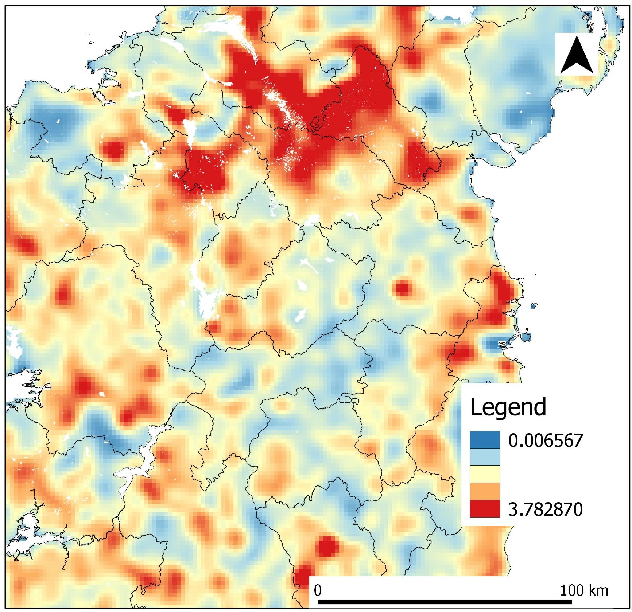
Sampling intensity
Option A:
convert plots → points
overlay on ecoregion/country polygons
summarize per polygon
Option B:
treat ecoregions/countries as spatial polygons
compute density per region
R packages:
sf (spatial geometry)
rnaturalearth (base maps)
ggspatial
spatstat (kernel density)
Implemented as a country-level sampling-intensity map. Kernel-density maps are not used because they may imply continuous sampling effort between discrete localities.

Slide 11
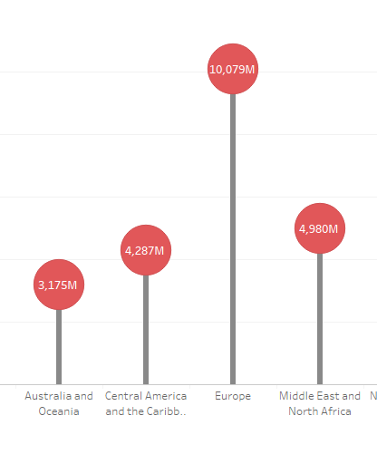
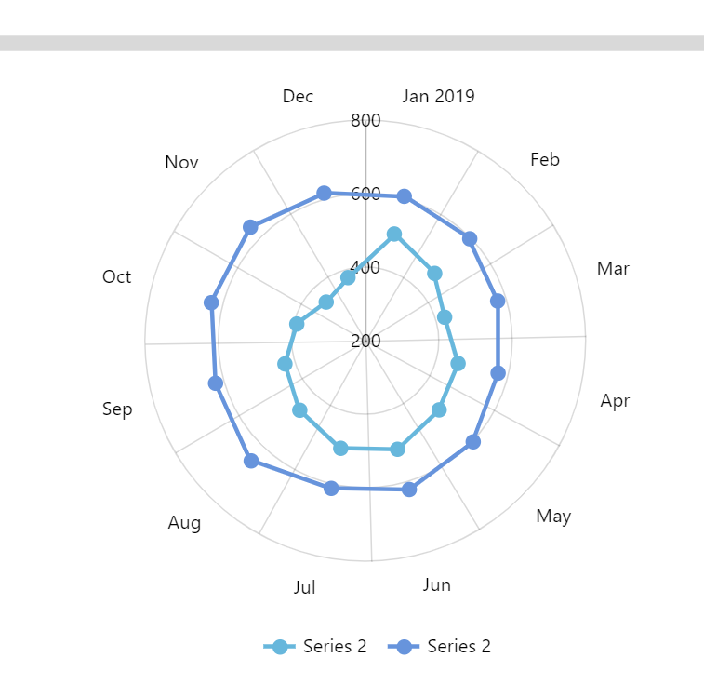
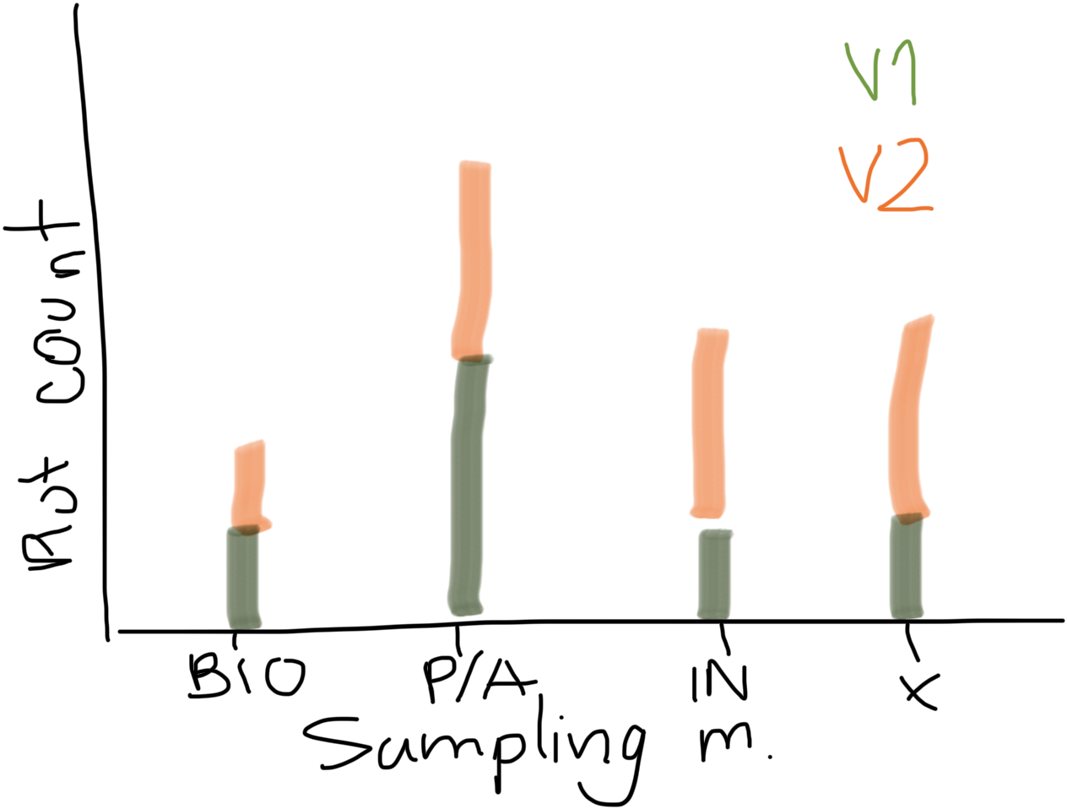
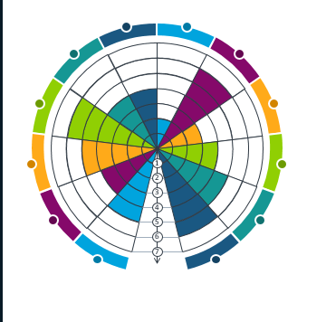
Sampling structure
Dumbbell plots are used consistently; radial and fan charts are not retained.
No. plots
Implemented as separate comparisons of sampling-unit type, abundance information, field sampling method and sampling-unit strategy.

Slide 12

Icon-based charts — not retained
Decision: not retained. Exact counts and percentage changes are presented in a table, avoiding decorative icons and licensing issues.
X trees in V1 vs Y trees in V2
Sample icons from Google. Not licensed!!

Slide 13
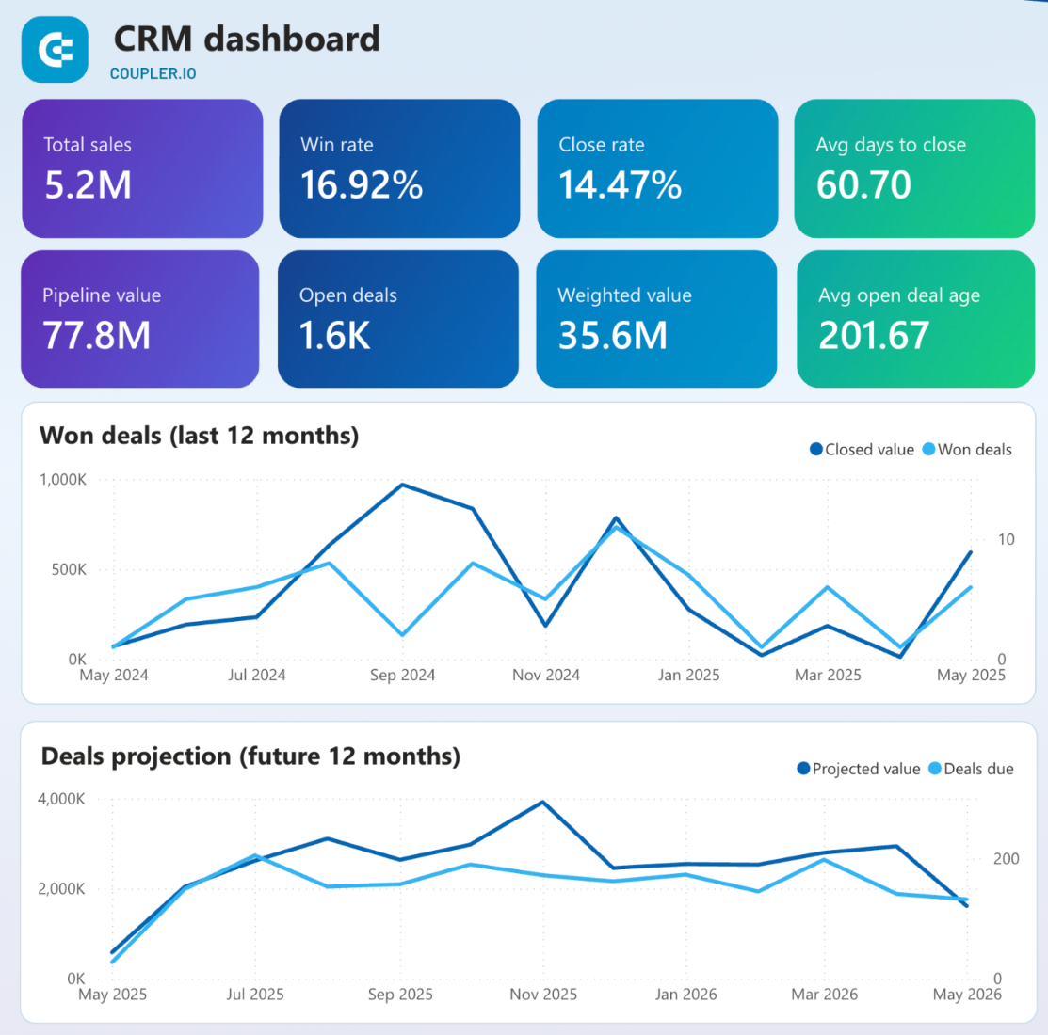
Overall database growth — KPI table retained
Implemented as a compact table of values and percentage changes calculated directly from the current database objects.
+10% datasets
+5% altitude
24m mean tree DBH

Slide 14
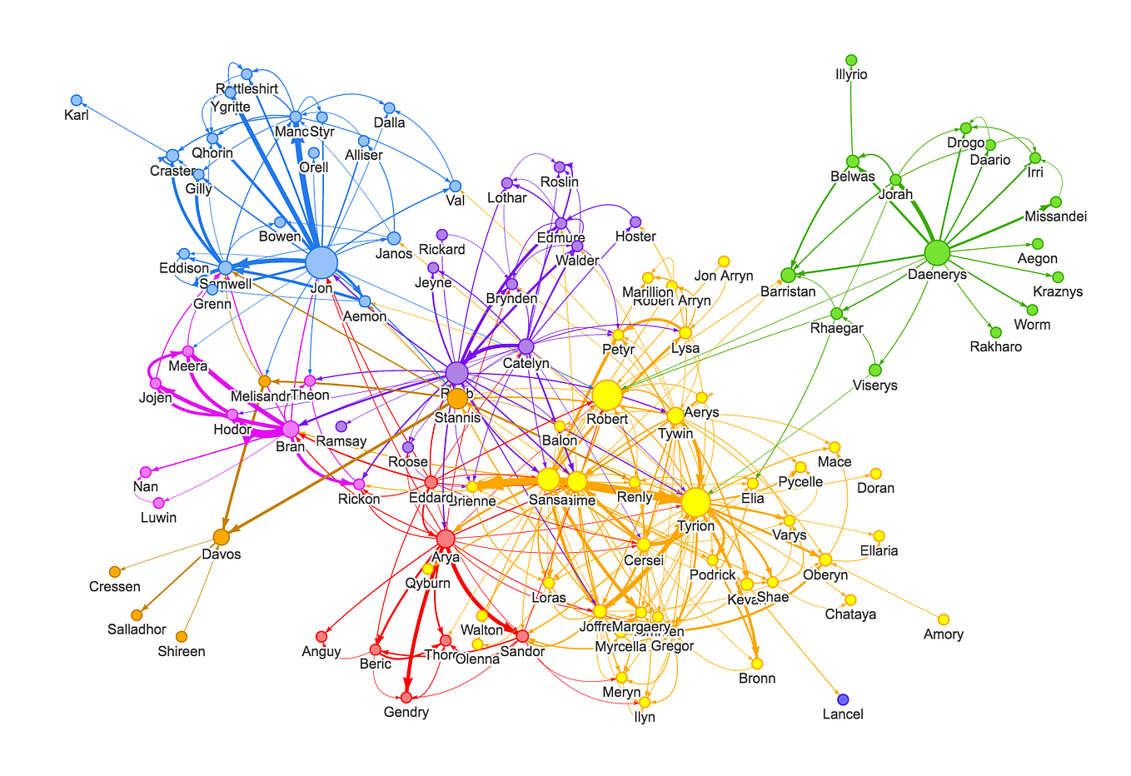
Network graphs — not retained
Decision: not retained for the database-description results. Network analyses would address host–epiphyte associations and belong in a separate ecological analysis.
Nodes:
tree species
epiphyte types or genera
Edges:
Epiphyte per tree

Slide 15
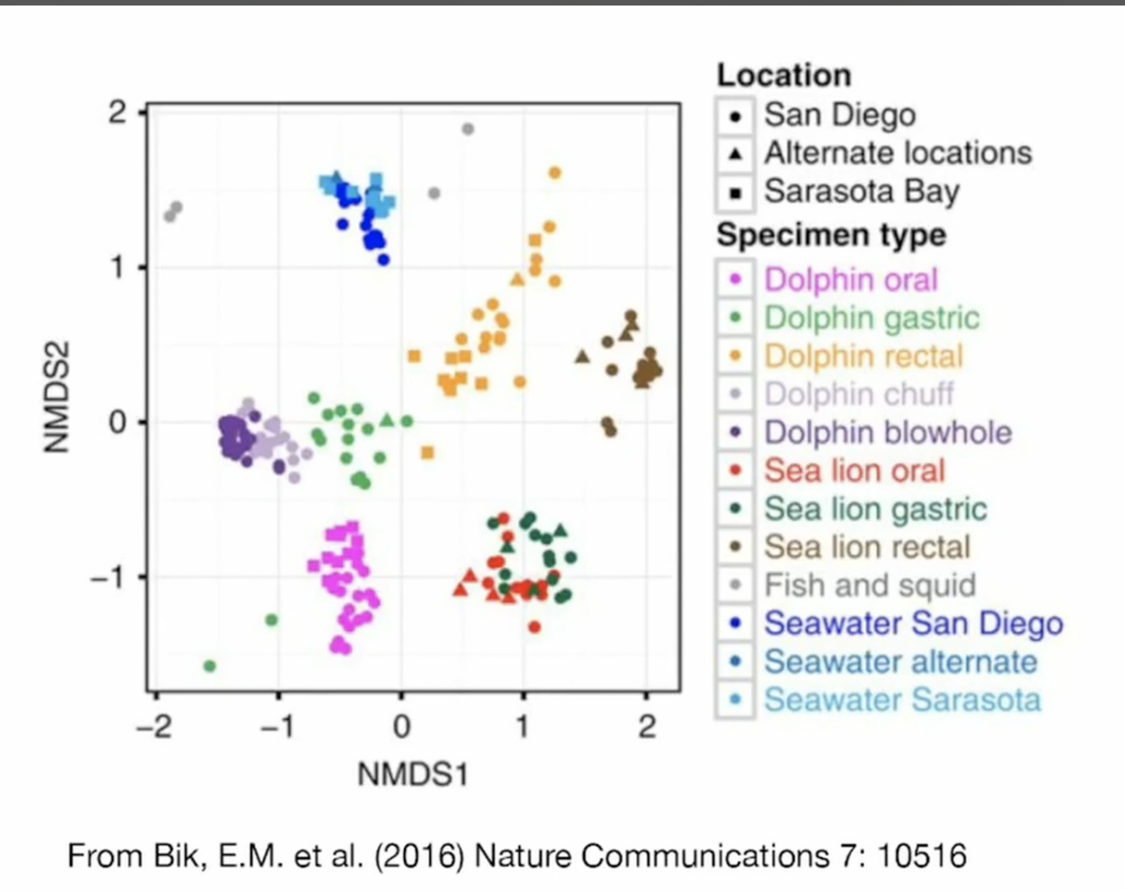
PCA/NMDS — not retained
Note: it uses a lot of RAM if run for the entire DB, so if using it, suggest to do subsets, which might defeat the purpose of V1 vs V2
V1 & V2
Decision: not retained. Ordination addresses compositional structure rather than the descriptive expansion and coverage of the database.
You convert categories into numeric structure via:
one-hot encoding
or distance matrices
PCA (Principal Component Analysis)
reduces dimensionality
finds main axes of variation
NMDS (Non-metric Multidimensional Scaling)
better for ecological data
preserves rank distances
What you get:
A 2D plot where:
each point = sample
distance = similarity
V1 = clustered, narrow diversity
V2 = expanded ecological space
Taxo scope

Slide 16
Results generated by the updated QMD

Slide 17
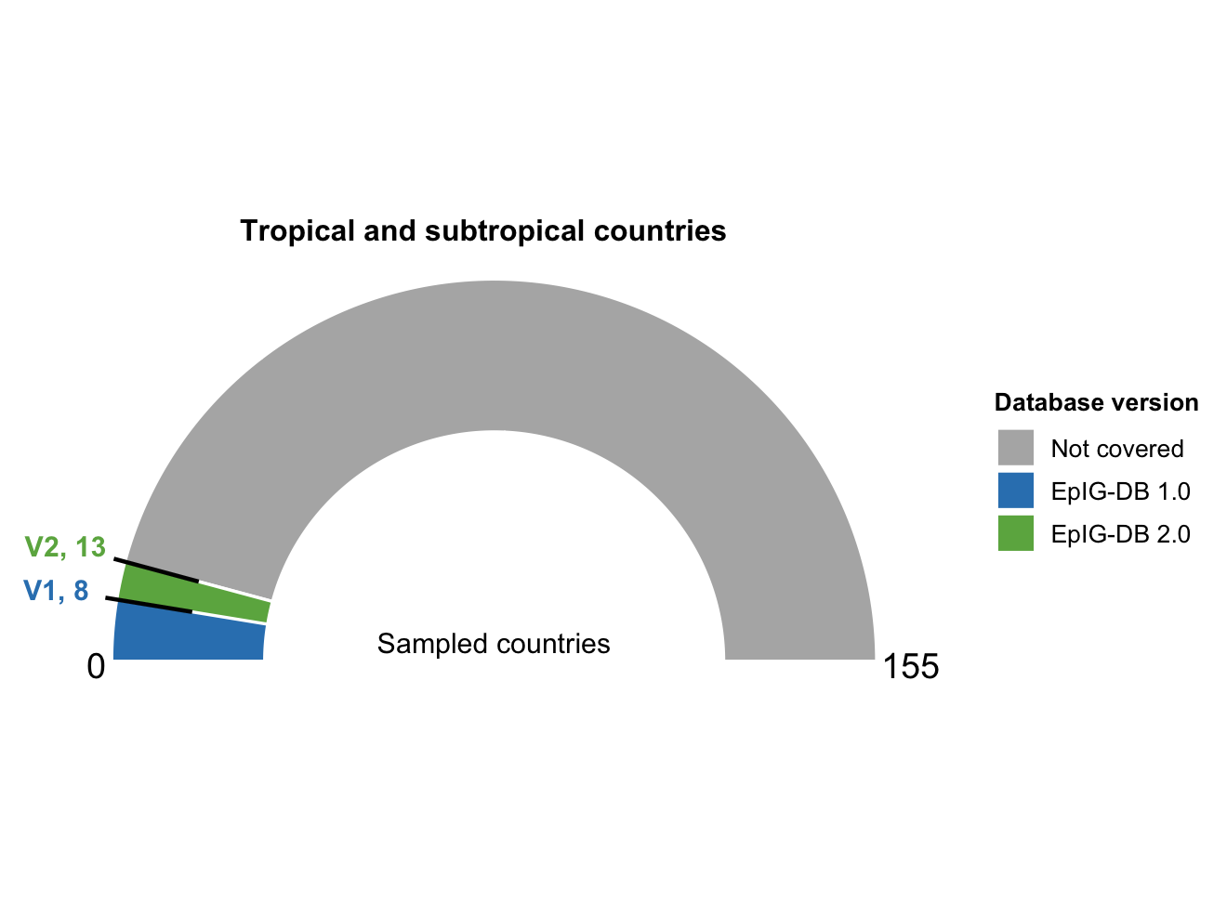
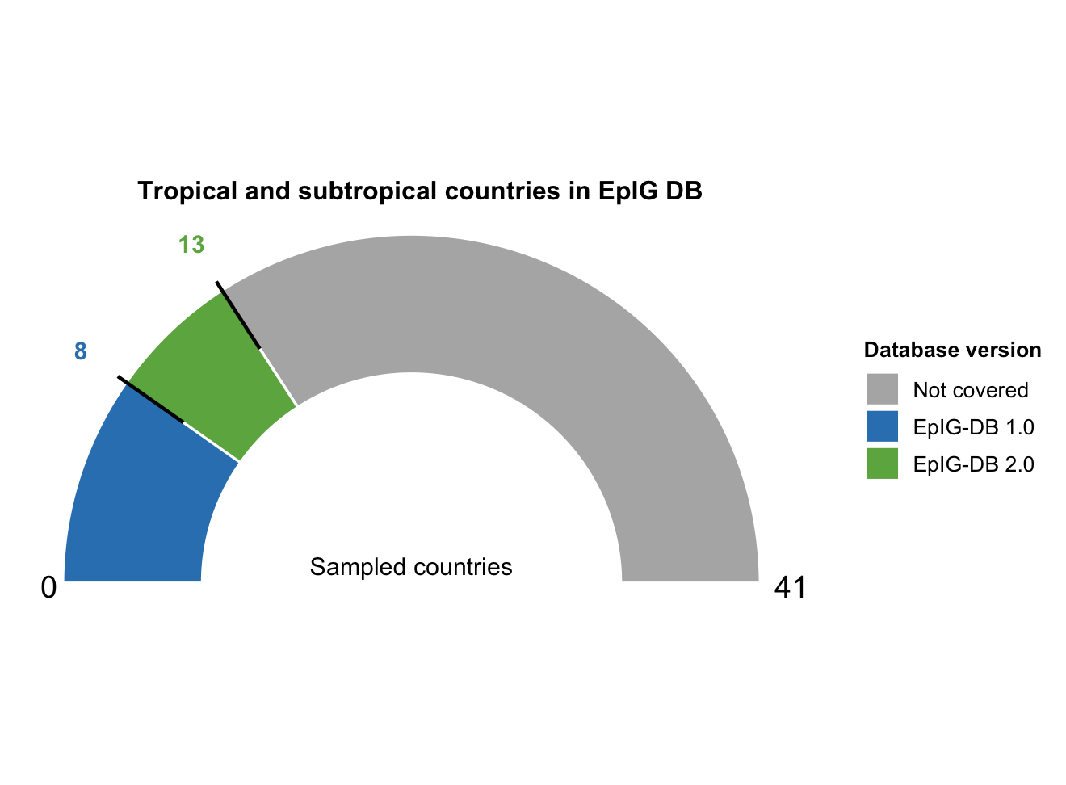
Gauge chart — superseded
Decision: removed. Country coverage is now presented as an exact comparison and a geographic-expansion map.

Slide 18
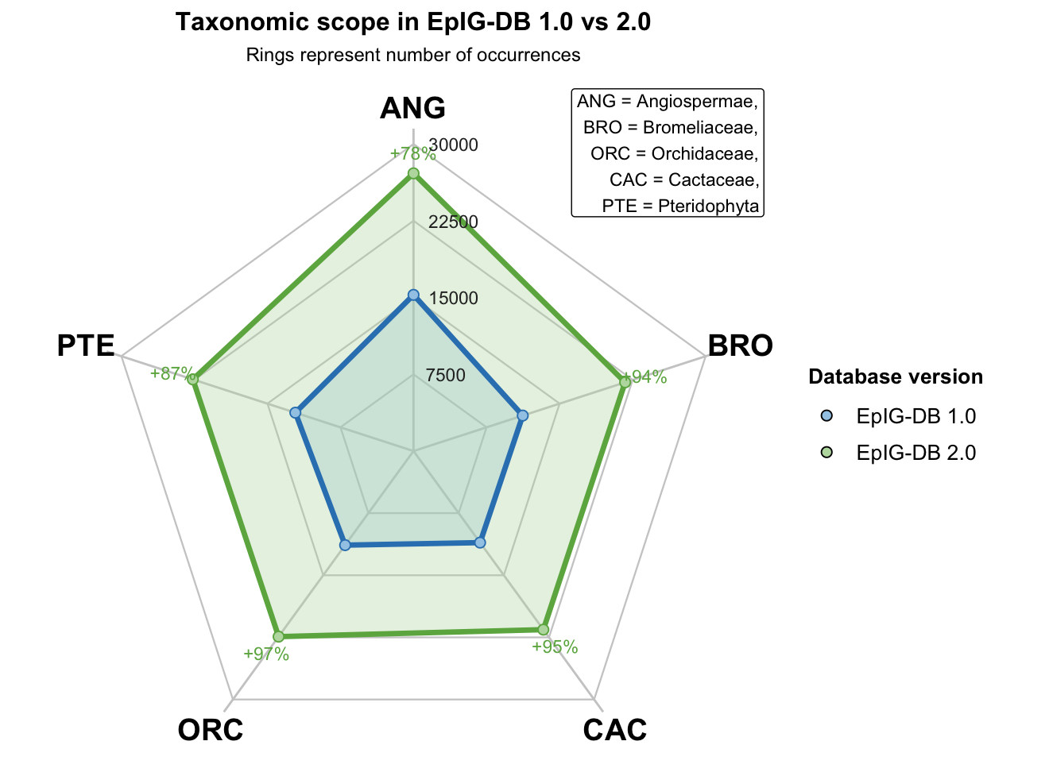
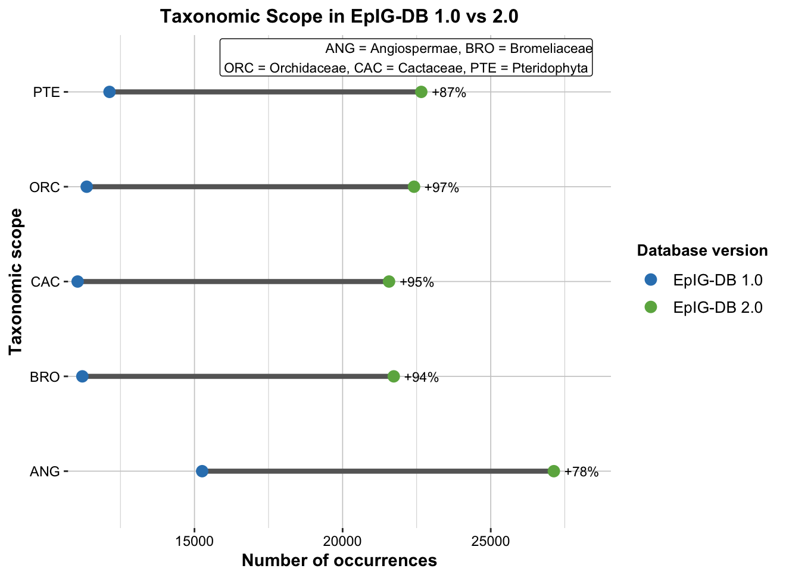
Taxonomic scope

Slide 19
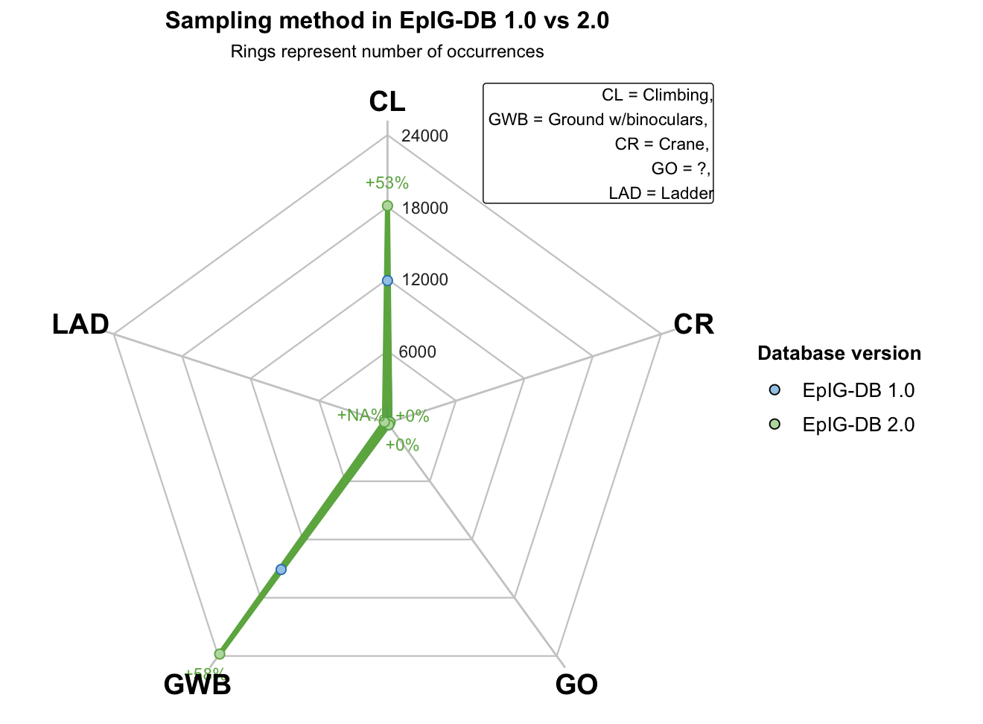
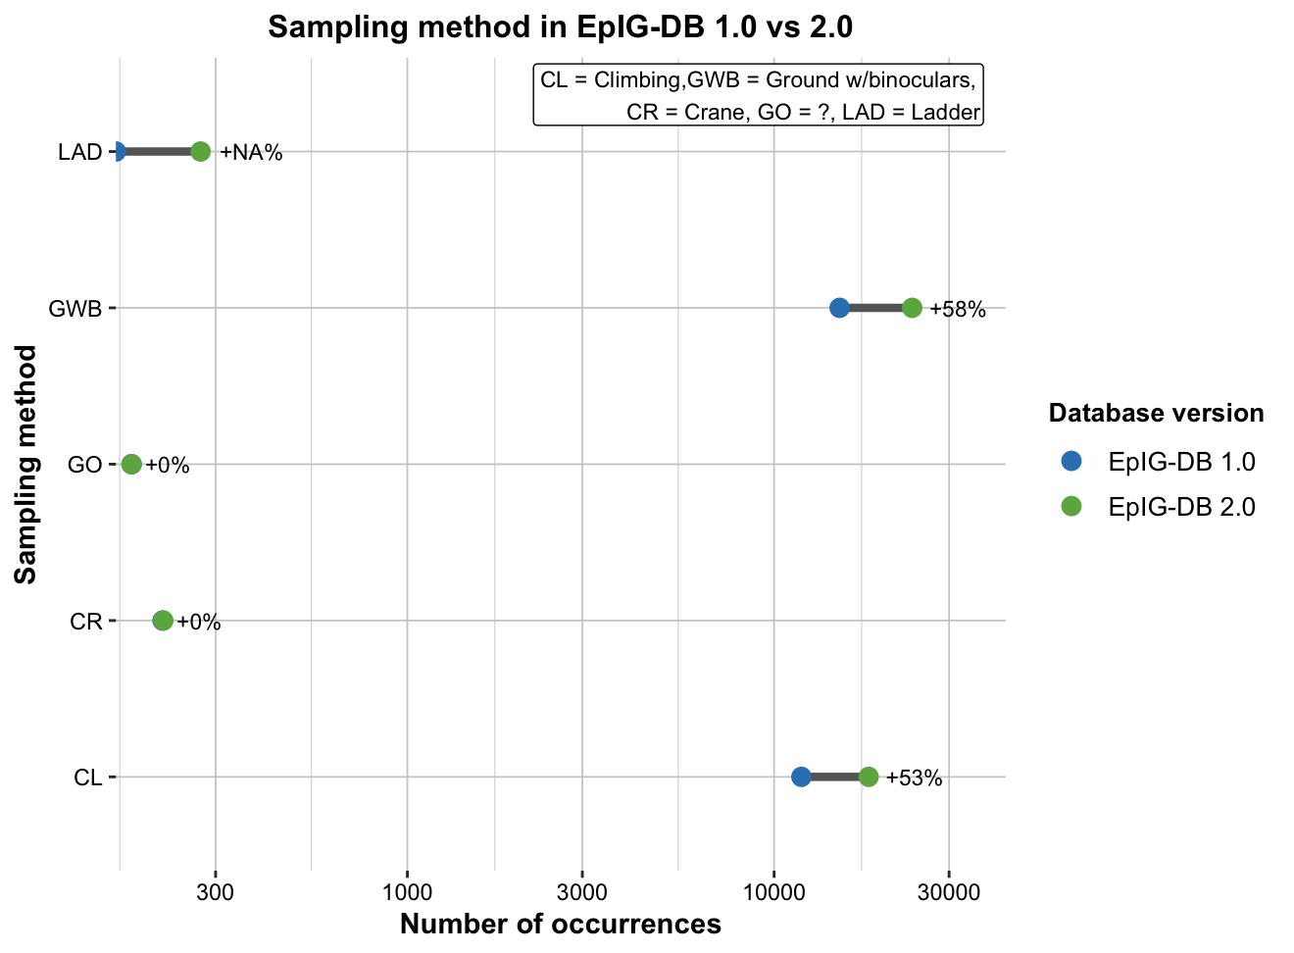
Sampling methods
Updated approach: the dumbbell plot uses a pseudo-logarithmic scale, which retains zero values while displaying strongly unequal category frequencies.

Slide 20
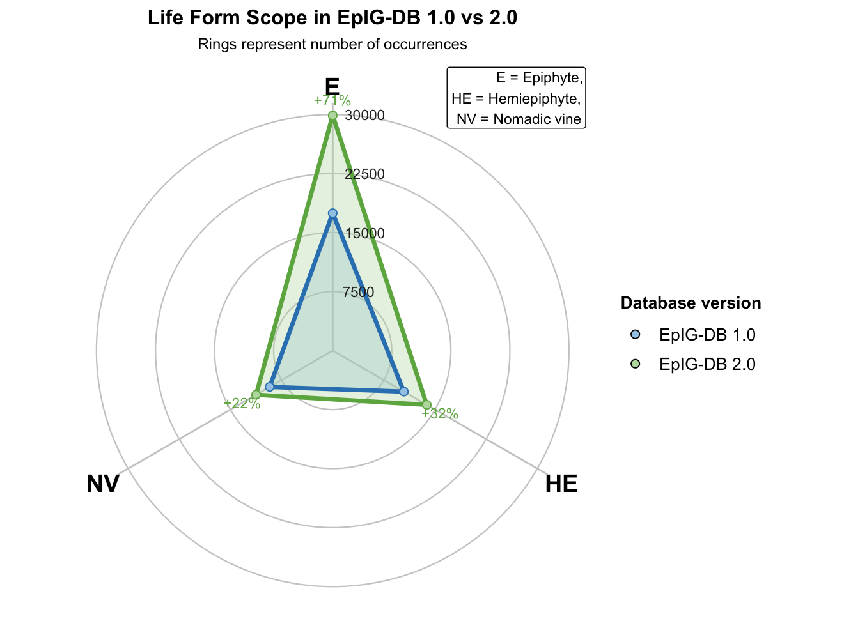
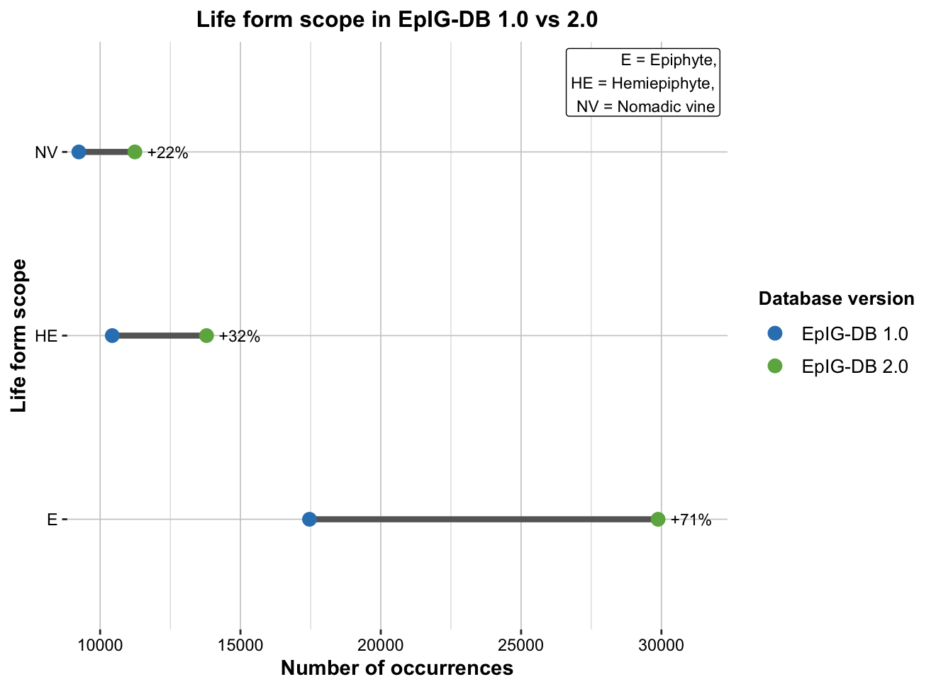
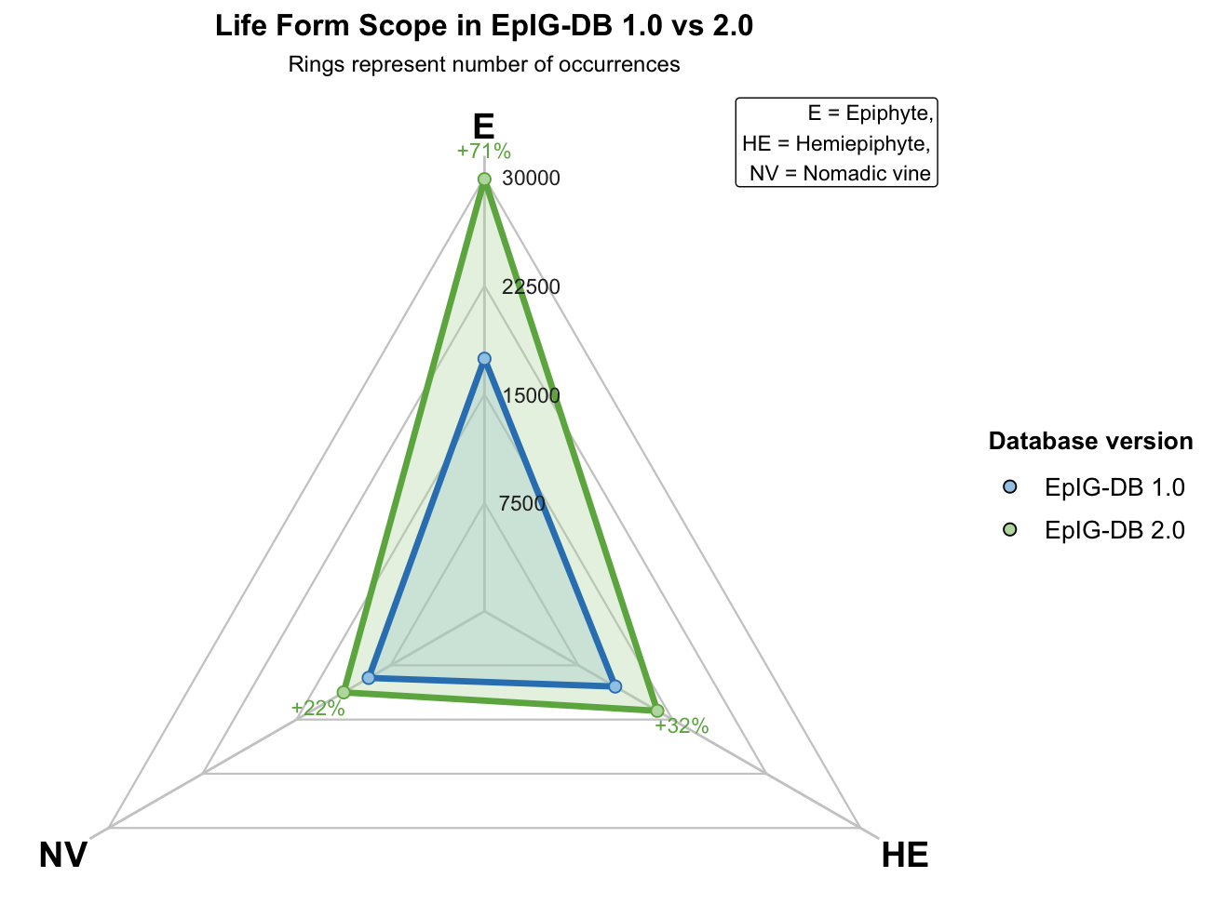
Life-form coverage

Slide 21
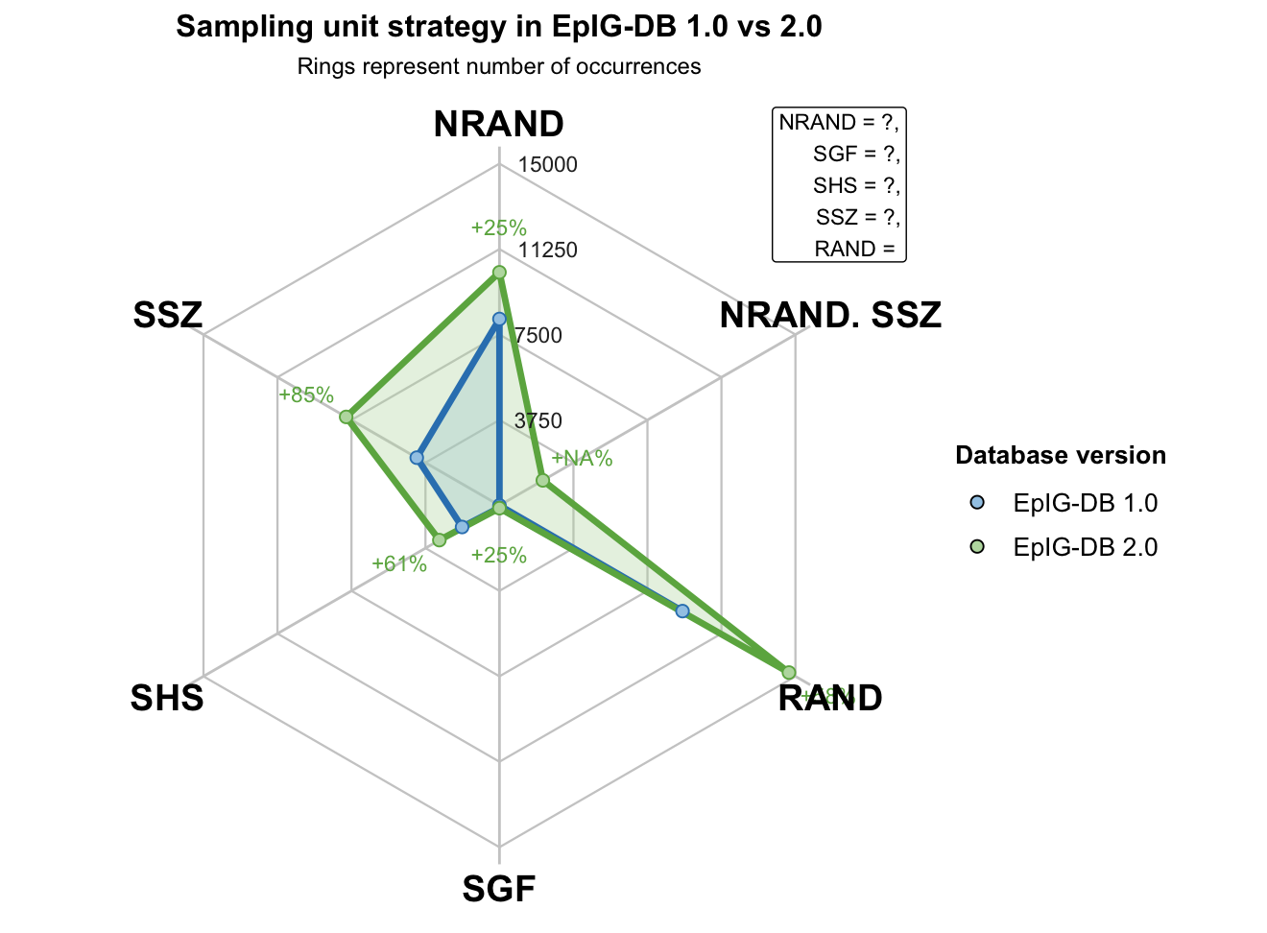
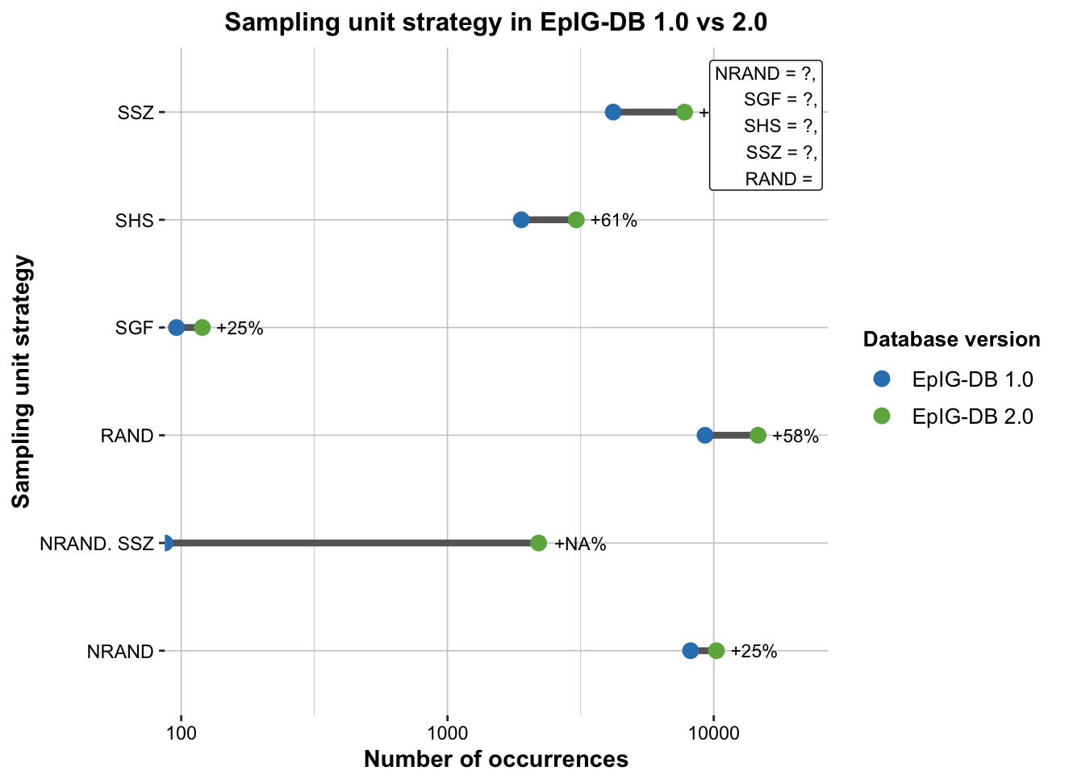
Sampling strategies
Updated approach: period- and comma-separated combinations are standardized before counting. Codes remain abbreviated until their definitions are verified against the data dictionary.

Slide 22
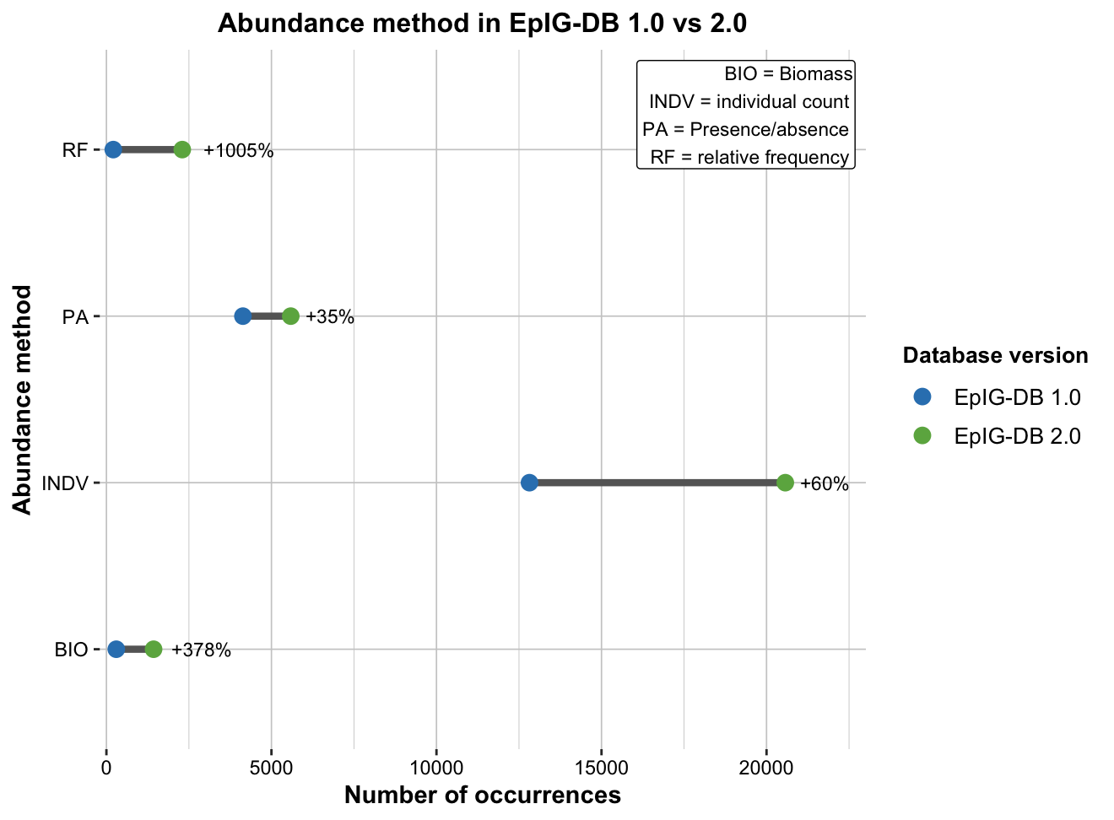
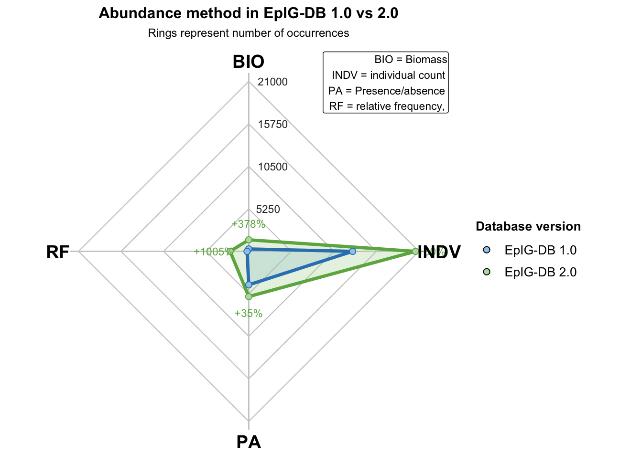
Abundance information

Slide 23
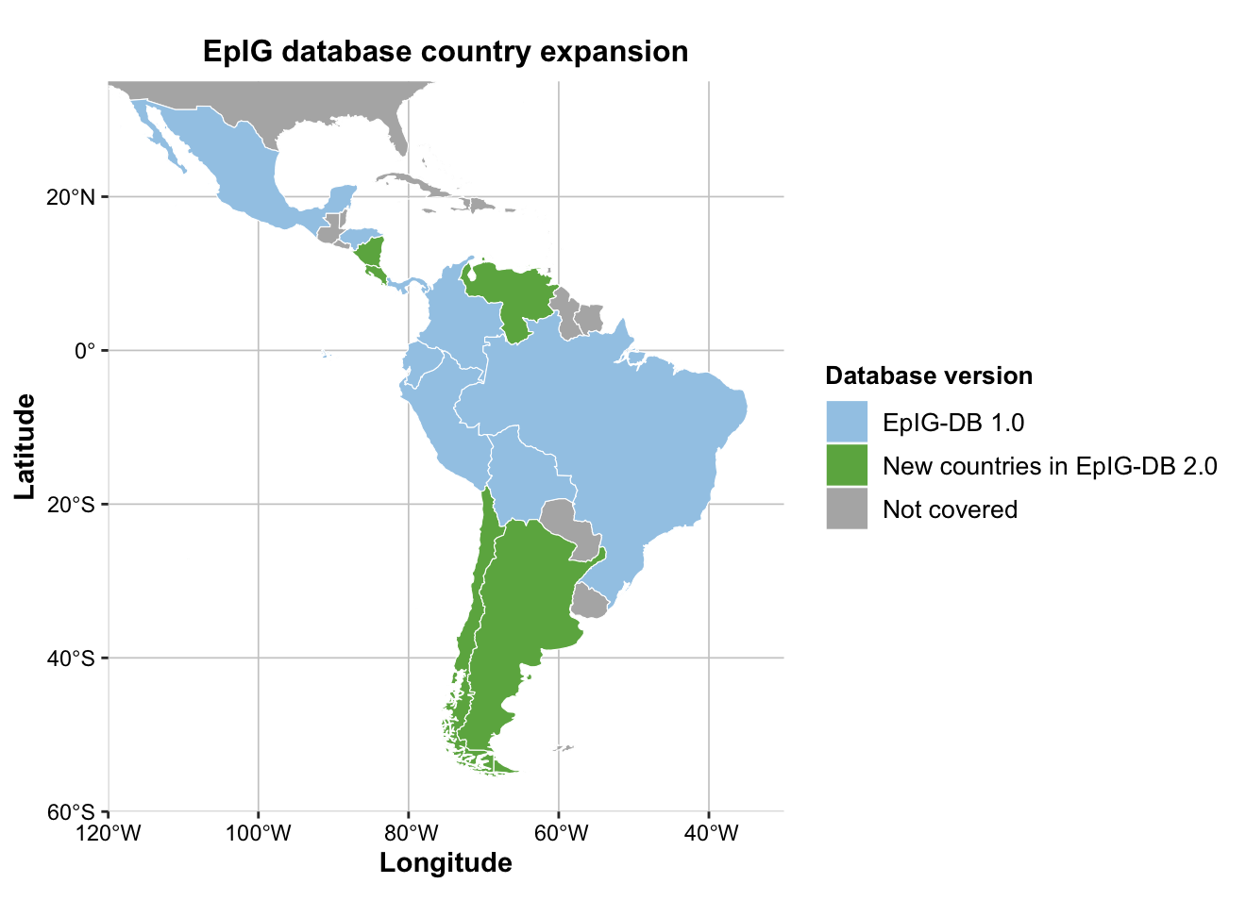
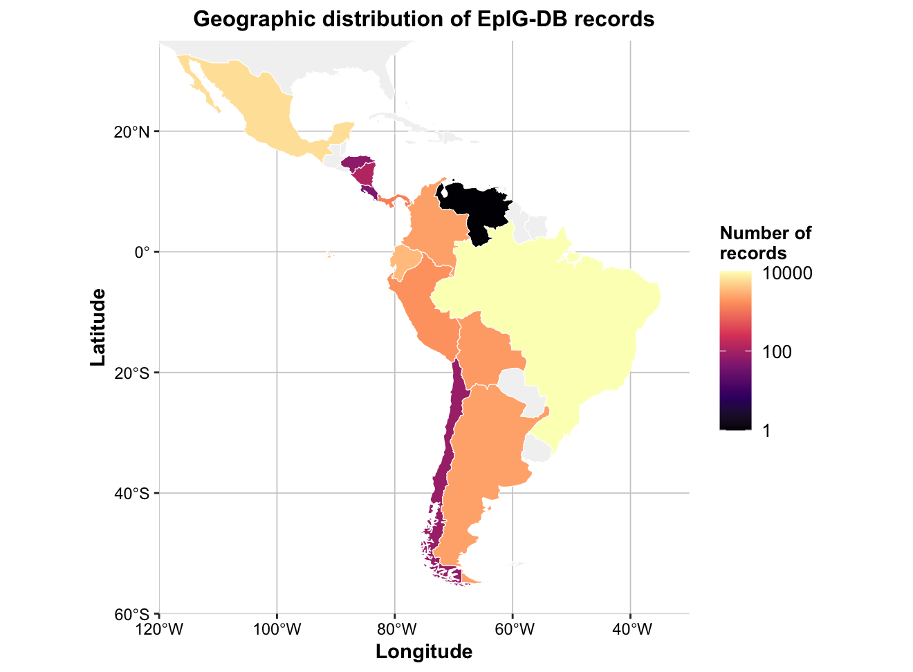
Geographic expansion

Slide 24
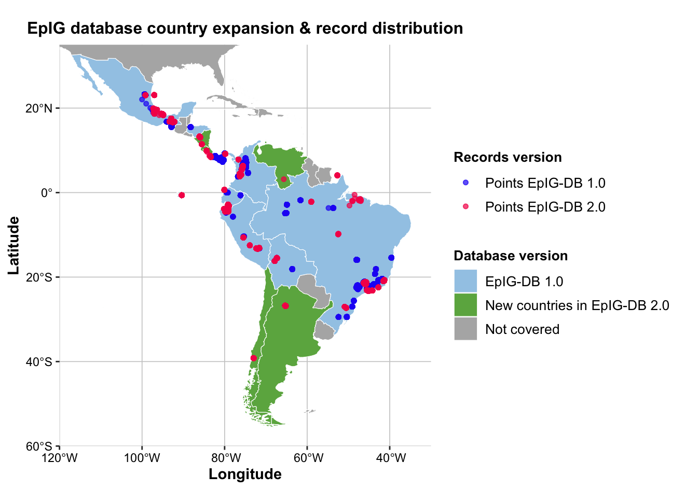
Sampling distribution

Slide 25
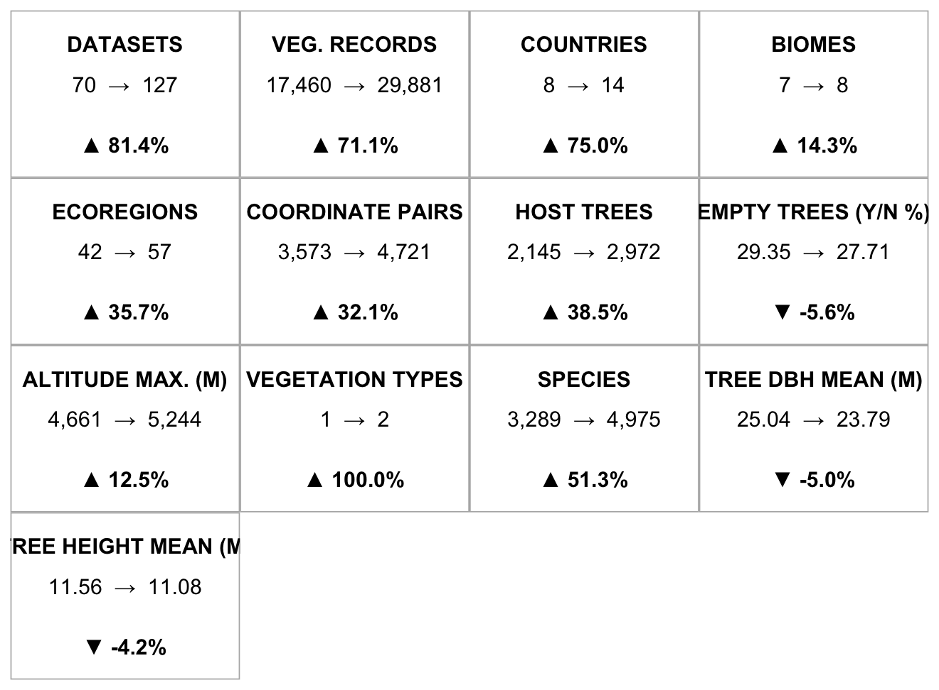
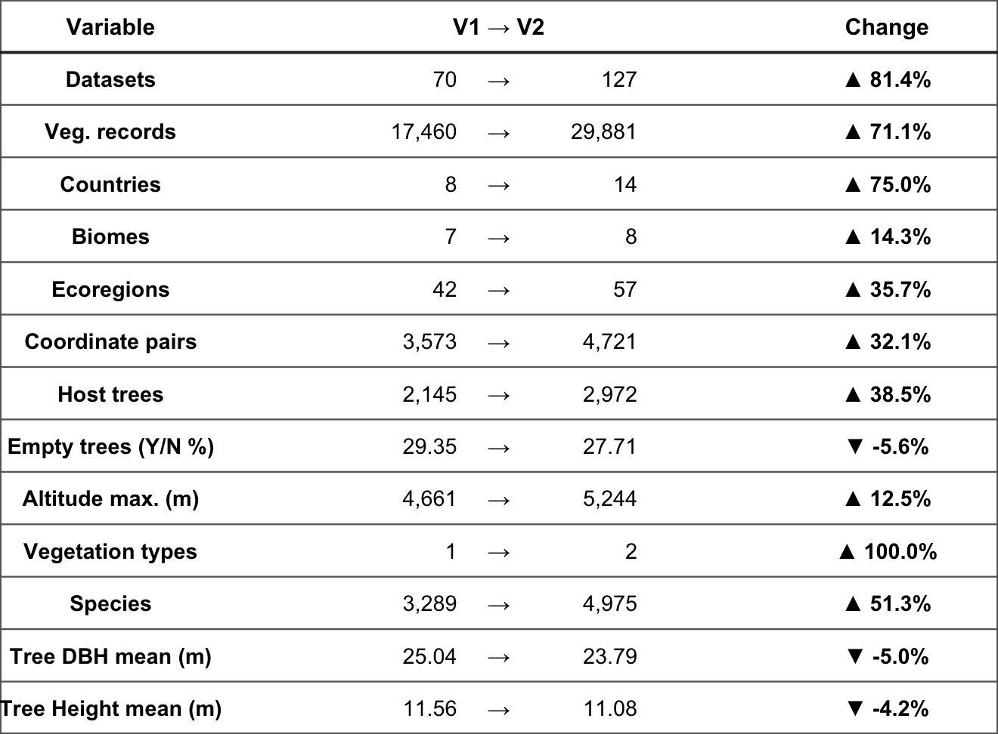
Overall database growth
Updated approach: all values are derived from the database. Hard-coded vegetation-type counts are omitted; DBH is labelled in centimetres; and numeric ranges are reported separately from coverage counts.

